Slide 1
Angioplasty optimization
Dr K V Patil

Slide 2
Topics included
Physiologic assessment of coronary artery disease
  CFR
  FFR
  IFR
Intracoronary imaging
  IVUS
  OCT

Slide 3
Why optimization?
Angiography – 2D images
  Angulations
  Artifacts: Contrast streaming, branch overlap,
  vessel foreshortening, calcifications,
  bifurcation origins
  Significance of intermediate lesions
  Significant lesions in diffusely diseased vessels
  Determination of Optimal stent deployment
  Complications of stenting

Slide 4
Physiologic assessment
Hyperemia – concept
  Coronary blood flow can increase from a resting level to a maximum (~ 3 times) - increases in myocardial oxygen demand or in response to neurogenic or pharmacologic hyperemic stimuli
  Myocardial precapillary arteriolar resistance vessels

Slide 6
CFR
Ratio of maximal to basal arterial flow
No true “normal CFR,” lower CFR <2.0
combined measure of the capacity of the major resistance components—the epicardial coronary artery and the supplied vascular bed
Low CFR ?which component is affected – limited clinical applicability for specific lesion
May be reduced in normal coronary arteries and either hypertension or aortic stenosis - myocardial hypertrophy and an abnormal microvasculature
Altered by changes in basal and hyperemic flows, both influenced by hemodynamics, loading conditions, and contractility
best used to assess the microcirculation in the absence of epicardial artery narrowings

Slide 8
2013 2019

Slide 9
FFR
Ratio of maximum flow between the stenotic artery and the same artery free from stenosis
Ratio of pressure distal to a coronary stenosis to the pressure proximal to the coronary stenosis at maximum flow conditions

Slide 10
Lesion-specific index – independent of microcirculation, heart rate, blood pressure, and other hemodynamic variables
-De Bruyne et al.
Normal value of 1.0 for every patient and every coronary artery
High reproducibility and low intraindividual variability
Independent of sex or CAD risk factors (hypertension and diabetes)
less variability with common doses of adenosine
  Factors influencing: venous flow, collateral flow
Notes:
3. coefficient of variation between two consecutive measurements was 4.2%, which is lower than the 17.7% for CFR measured with a Doppler wire

Slide 11
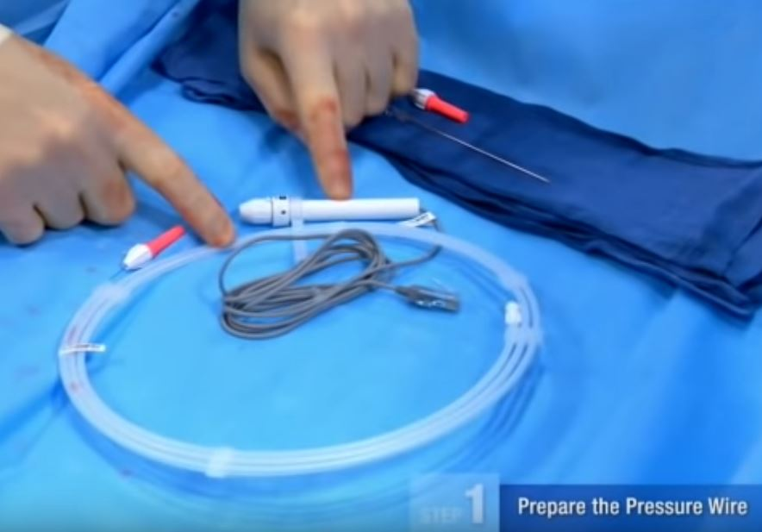
METHODOLOGY OF CORONARY
PRESSURE MEASUREMENT
General Setup and Guidewire Manipulation
sensor guidewire passed through an angioplasty Y-connector attached to a guiding catheter
Anticoagulation (intravenous [IV] heparin) given beforehand
Intracoronary (IC) nitroglycerin
(100 to 200 μg) - before advancing
the guidewire into
artery –minimizes
measurement variability
caused by vessel spasm

Slide 12
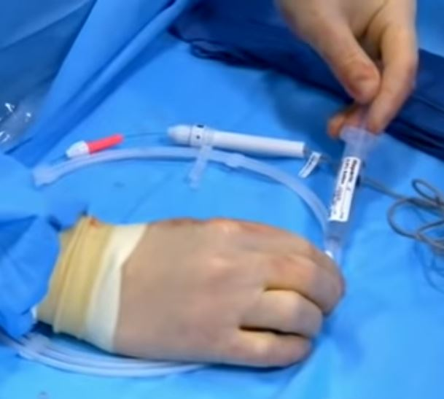
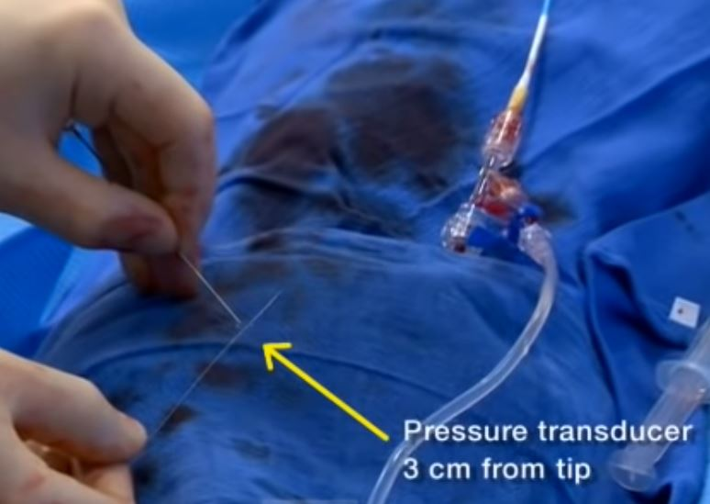
Notes:
2. at the junction of the radiopaque and radiolucent portions of the wire

Slide 15
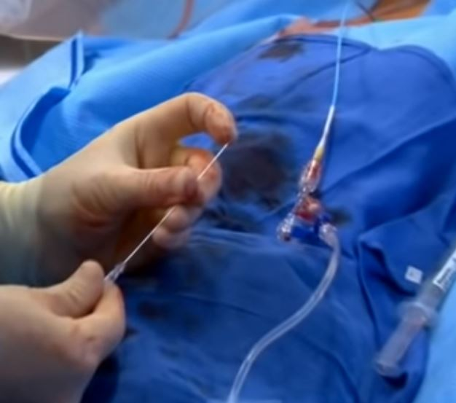
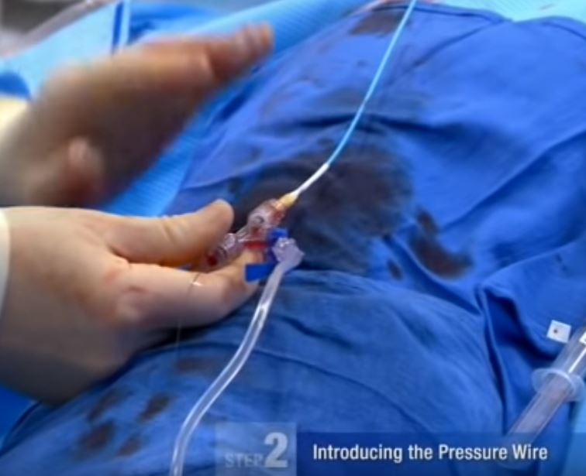

Slide 16
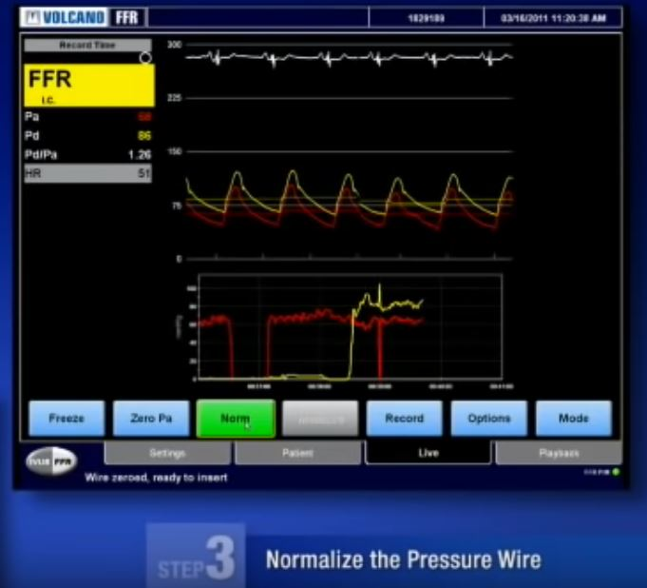
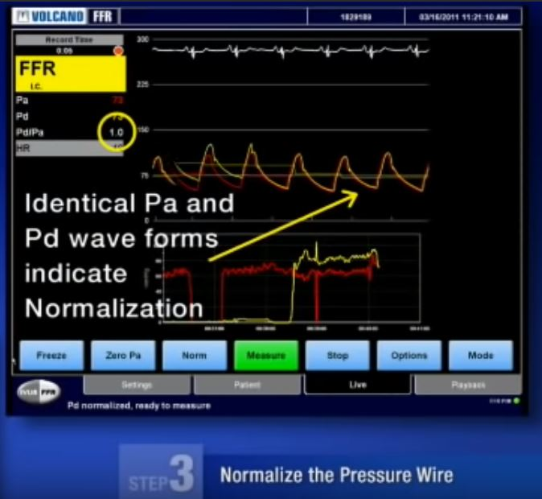

Slide 17
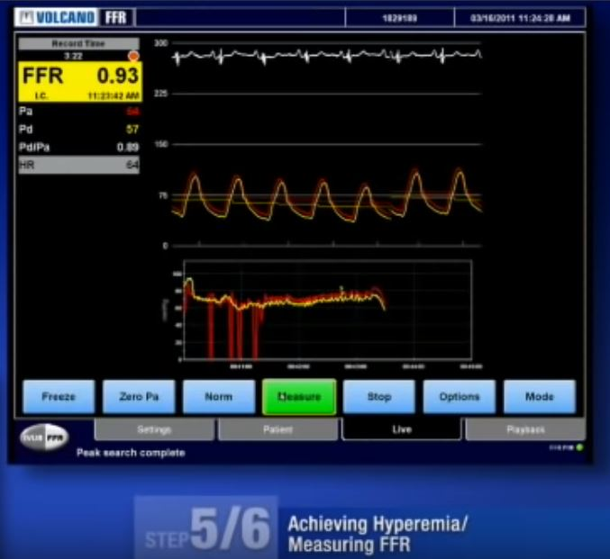

Slide 19
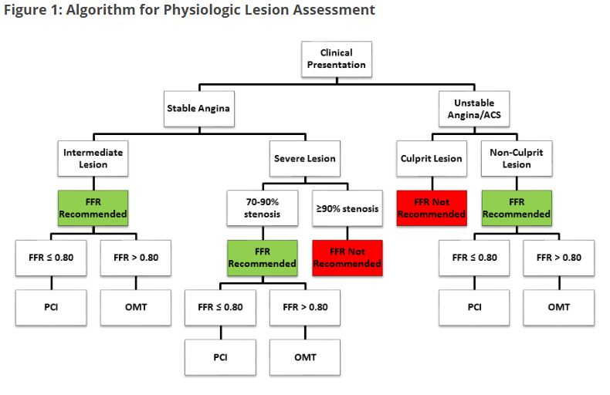

Slide 20
2019

Slide 21
IFR

Slide 23
Wave-free period (WFP) occurs in diastole - generation of new waves is absent and competing waves that affect coronary blood flow are quiescent

Slide 24
Defining features of the WFP
  flow velocity approximately 30% higher than whole-cycle resting flow velocity
  intracoronary pressure and flow decline together in a linear fashion
  microvascular resistance significantly more stable and lower than that over the rest of the cardiac cycle

Slide 25
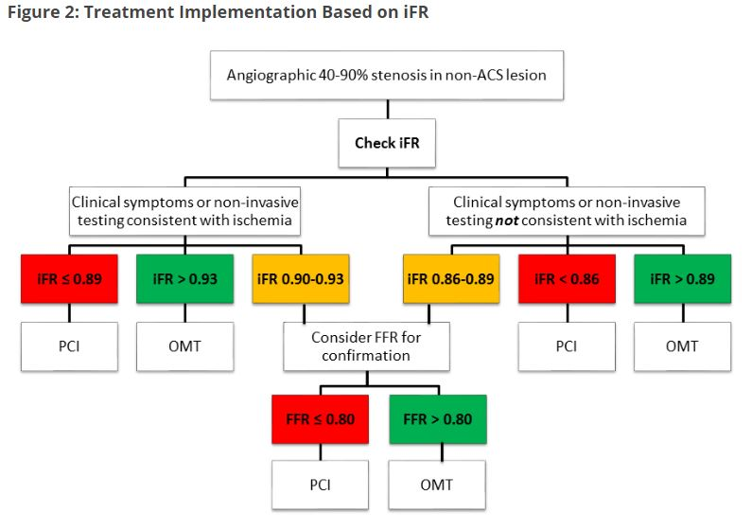

Slide 26
IVUS & OCT

Slide 27
IVUS: Basic principles
Reflected sound waves to visualize the vessel wall in a two-dimensional, tomographic format, analogous to a histologic cross section
Significantly higher frequencies than noninvasive echocardiography (20 to 45MHz)
Theoretical lower limits of resolution (calculated as half the wavelength) of 31 and 19 μm, respectively
In practice, radial resolution at least two to five times poorer (i.e., 80 to 150 μm) - Determined by
  Length of the emitted pulse
  Position of the imaged structures relative to the transducer
Notes:
IVUS uses
Greater resolution, lesser penetration; as compared to 2 -7 MHz

Slide 28
Systems
US
  Boston scientific (iLab, Polaris)
  Volcano (s5,s5i)
Japan
  Terumo

Slide 29
Catheter designs
Solid-State Dynamic Aperture System
Individual elements of a circumferential array of transducer elements at catheter tip- activated with different time delays to create an ultrasound beam that sweeps the circumference of the vessel
Miniaturized integrated circuits in the catheter tip control timing and integration of the transducer activation
Ability to manipulate the beam electronically—ability to focus at different depths

Slide 30
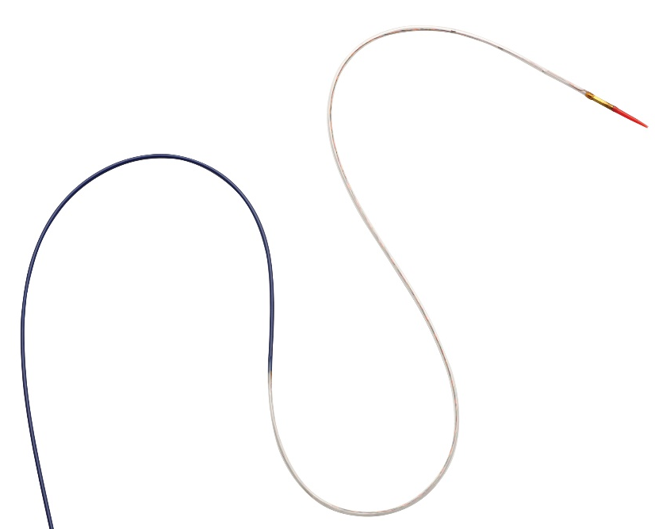
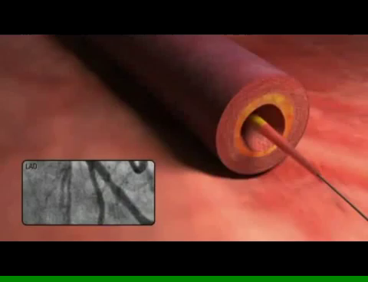
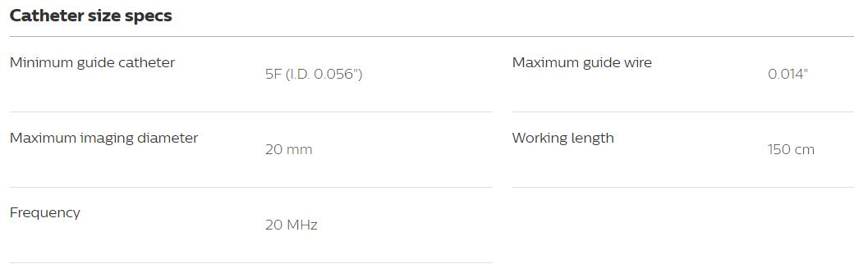
64 transducer elements arranged around the catheter tip and center frequency of 20 MHz
Latest catheters – rapid exchange - 3.5 Fr in scanner diameter and thus compatible with a 5-Fr guide catheter
Notes:
Philips-volcano-Eagle Eye Platinum digital IVUS catheter

Slide 31
Mechanically Rotating Single-Transducer System
single transducer element rotated at 1800 rpm, inside a protective sheath at the distal tip of a catheter, via a flexible torque cable that is spun by an external motor drive unit attached to the proximal end of the catheter
40- or 45-MHz transducer with a distal crossing profile of 3.2 Fr, compatible with 6-Fr (Infraredx, Burlington, MA; Volcano) or 5-Fr guide catheters (Boston Scientific Corporation, Natick, MA; Terumo Corporation, Tokyo, Japan)
Larger catheters with lower center frequencies available for intracardiac and peripheral imaging

Slide 34
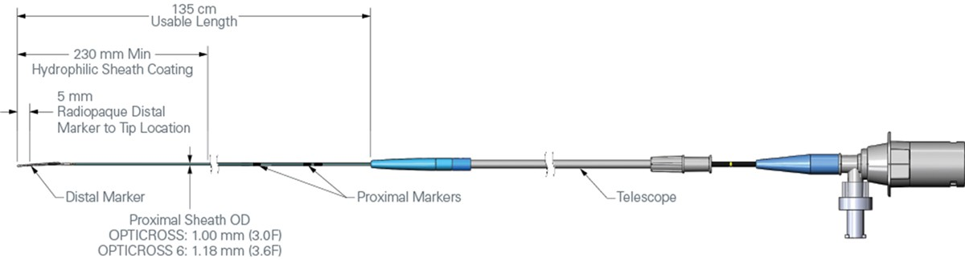

Slide 35
Mechanically Rotating Single-Transducer
Solid state dynamic aperture
Higher center frequency- higher resolution
larger effective aperture of a transducer
stationary outer sheath - transducer can be moved in a precise and controlled manner
longer, rapid-exchange design tracks better
distance of the transducer from the catheter tip is shorter - beneficial in IVUS-guided intervention of CTO
No moving parts – free from NURD
Both systems can be installed directly into the cineangiogram system

Slide 36
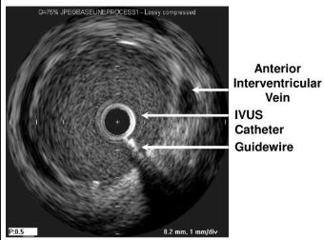
Guidewire runs outside the catheter, parallel to the imaging segment, results in a shadow artifact : Guidewire artifact

Slide 37
Artifacts
Ring down-“Halo” or a series of bright rings immediately surrounding the mechanical intravascular ultrasound catheter (arrow) -usually caused by air bubbles that need to be flushed out
Radiofrequency noise- alternating radial spokes or random white dots in the far-field
Interference from other electrical equipment
“White cap” - side lobe echoes - from a strong reflecting surface, such as metal stent struts or calcification
mistaken impression of struts protruding into lumen, potentially interfering with area measurements and assessment of apposition, dissection
NURD - bending of the drive cable interferes with uniform transducer rotation -wedge-shaped, smeared appearance in one or more segments
Rx- straightening the catheter and motor drive assembly, lessening tension on the guide catheter, or loosening the hemostatic valve of the Y-adapter

Slide 38
“Wrinkling” (or “accordion”) artifact
Artificial vessel kink associated with intravascular instrumentation (a guidewire or imaging catheter)
Abrupt change of arterial dimensions with external compression by a heterogeneous or low-echoic structure (arrows) partially surrounding the artery

Slide 39
Imaging Procedure
5000 to 10,000 units of heparin (ACT >250)
Intracoronary nitroglycerin (100 to 200 μg)
Image integrity of the IVUS system is checked
Mechanical catheters - saline flush before insertion to eliminate air in protective sheath
Solid-state catheter - tip positioned in the aorta or a large proximal coronary vessel (not adjacent to any vessel wall) to electronically subtract ring-down artifact

Slide 40
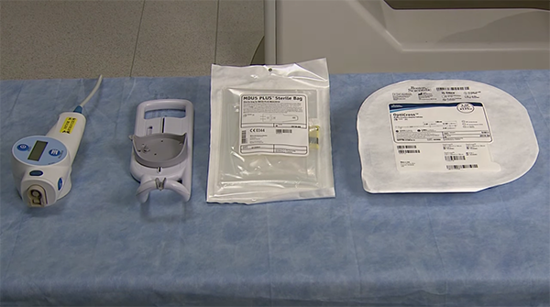
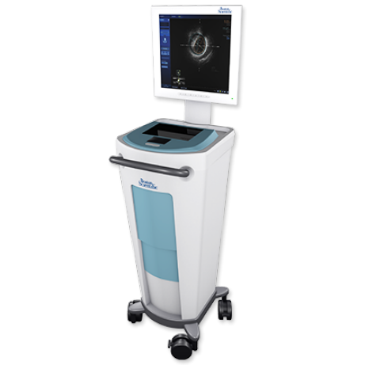
POLARIS Multi-Modality Guidance System (Integrated or Mobile)
MDU5 PLUSTM Motor Drive Unit
Automatic Pullback Sled (optional)

Slide 41
Imaging element is advanced at least 10 mm distal to the area of interest over a standard 0.014-inch angioplasty guidewire
Length of the target vessel systematically scanned by retracting the transducer within the protective sheath (mechanical system) or by withdrawal of the entire catheter (solid-state system)
Automated pullback devices- withdraw the imaging element at a steady rate of 0.5 or 1.0 mm per second
  accurate axial registration of each cross section for serial studies or precise longitudinal distance measurements.

Slide 42
Co-registration of the ultrasound image with contrast angiography, providing precise localization of the ultrasound findings on the angiogram
Image acquisition recommended to include the distal vessel, the lesion site, and the entire proximal vessel back to the aorta
Aorto-ostial segment requires that the guide catheter be disengaged slightly from the ostium

Slide 43
Safety
Risks - spasm, dissection and thrombosis
1% to 3% - transient spasm - most frequently reported event
Major complications (dissection, thrombosis and abrupt closure) - <0.5%
Studies in 1990’s with 1st gen catheters

Slide 44
Image interpretation
Three-Layered Appearance of Arterial Wall
Relative echolucency of the media compared with the intima and the adventitia gives rise to a three-layered appearance (bright–dark–bright)
Spillover effect/blooming - seen at the intima–media border
  Slight overestimation intimal thickness and a corresponding underestimation of medial thickness
  Media can appear artifactually thick when ultrasound signal attenuation occurs within the intimal layer
Media–adventitia border, corresponding to the external elastic membrane (EEM), is accurately rendered
Adventitia and peri-adventitial tissues are similar enough in echoreflectivity
Notes:
Media - less collagen and elastin than in the neighboring layers

Slide 45
Young individuals
  Lower echoreflectivity of intima, internal elastic lamina and higher elastin content of media
Patients with a significant plaque burden
  Thinning of media underlying the plaque
➔ plaque-plus-media cross-sectional area (CSA) is adopted as a surrogate measure for plaque CSA
Notes:
Adding in the media represents only a tiny percentage increase in the total CSA of the plaque.

Slide 46
IMAGE ORIENTATION
IVUS beam penetrates beyond the artery - images of perivascular structures including the - useful landmarks with regard to longitudinal and cross-sectional image orientation
  Pericardium - bright and relatively thick layer with varying degrees of “spoke-like” reverberations created by interwoven fibrous strands
  Myocardium - viewed on the side opposite to the pericardium as a variable pattern of homogenous, low-echoic gray-scale signals
  Cardiac veins

Slide 47
LMCA LCX RCA
Notes:
proximal portion of the left main coronary artery, a clear echo-free space filled with pericardial fluid, called the transverse sinus, is found adjacent to the artery, immediately outside the left lateral aspect of the aortic root
great cardiac vein (GCV) runs superior to the LCx in most cases and immediately inferior to the left auricle. Obtuse marginal branches emerge opposite the GCV.
At the level of the middle right coronary artery, the veins arc over the artery, typically at a position just adjacent to the right ventricular (RV) marginal branches

Slide 48
Notes:
A, Incomplete expansion relative to the ends of the stent and the reference segments.
B, An edge dissection with a disruption of plaque (arrow) at the stent margin.
C, Significant residual plaque burden at the segment uncovered by the stent.
D, Spasm at the adjacent nonstented segment.
E, Incomplete apposition, in which there is a gap between a portion of the stent (arrows) and the vessel wall.
F, Tissue protrusion (plaque prolapse, thrombus, or both) (arrows) within the stent.
G, Intramural (intravascular) hematoma detected as an accumulation of blood within the medial space (arrows) starting from the edge of the stent.
H, Extramural (extravascular) hematoma (arrow) visualized as an irregularly shaped, echodim pattern in the perivascular tissue.

Slide 49
Minimal luminal area
LMCA
  5.9 to 7.0 sq mm
  Safety for 6.0 as threshold tested in a study(de Torre et al, JACC, Jul 2011)
Non-LMCA
  Major (non-LMCA) epicardial coronary arteries : 3.0 to 4.0 mm²

Slide 50
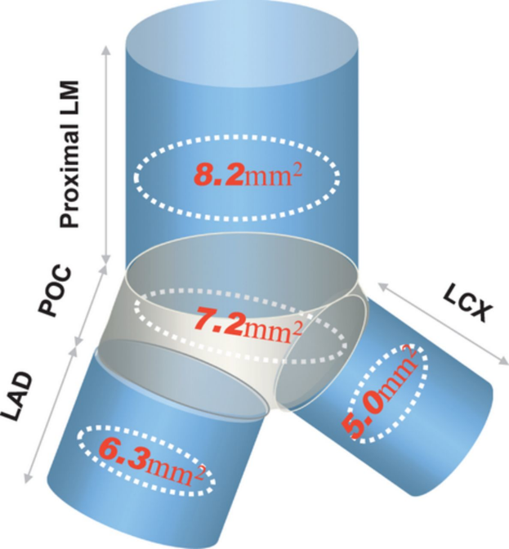

Slide 51
Peri-interventional assessment
  calcium, dissection, thrombus, excessive plaque burden
  Selection of balloon size
  Selection of stent size and length (esp for BVS)

Slide 53
Notes:
recently proposed classification focuses on potential mechanisms of the strut fracture, categorizing them on the basis of the presence (type I) or absence (type II) of aneurysm at the fracture site
2. Stent strut discontinuity (fracture) observed 8 months after deployment of three overlapping drug-eluting stents. On the cross-sectional intravascular ultrasound (IVUS) image (bottom row, middle image), an abnormal paucity of stent struts, not seen at baseline, was detected at a portion of the mid-stent. The longitudinal IVUS image (top) shows an acute-angled bend at the corresponding segment (arrows). In this particular case, however, the stent fracture (complete separation type) was not associated with increased intimal hyperplasia

Slide 54
Optical Coherence
Optical – Light
Coherence – Constant phase difference
Tomography - representation of a cross section

Slide 56
Principle
Optical interference of near-infrared light (wavelength ~1.3 μm)
Emitted and collected back from the tip of a small-diameter optical fiber that rotates rapidly inside a transparent sheath of the catheter
Light - absorbed and reflected (backscattered) by the structures in the tissue to different degrees
Collected light – carries information about depth-resolved backscattering reflectivity of the tissue structures at the illuminated spot
Image formed by the backscattering of light from vessel wall based on “echo time delay” with measurable signal intensity

Slide 57
2009,Europe; 2010 US: C7XR OCT system (St. Jude Medical) first commercially available FD-OCT system for coronary imaging
  2.7-Fr intravascular catheter with a rapid-exchange monorail tip
  spatial resolution - 15 μm, 500 axial lines/frame at a rate of 100 frames/sec
  tip of the catheter - a 125-μm-diameter optical fiber assembly consisting a side-looking lens
  assembly is encapsulated in a hollow torque wire that translates motion from a drive motor located outside
  5-cm vessel segment volumetrically imaged in ~3 seconds
  maximum 14-mL bolus of contrast material at a maximum rate of 4 mL/sec

Slide 58
  TD-OCT(1st gen): mirror that moves to produce variable, yet known echo delays
  FD-OCT(2nd gen):
    fixed mirror with a variable frequency light source or “swept laser”
    simultaneous detection of reflections from all echo time delays, making the system significantly faster

Slide 59
Axial resolution of 2 to 15 μm
Able to measure the density of cellular aggregates and to provide information about their composition

Slide 60
FD-OCT systems
2 types - differ in method of data extraction from the interferometer
  optical frequency domain imaging (OFDI)/swept-source OCT(SS-OCT)
  spectral domain OCT
SD-OCT
  Broadband light source (similar to TD-OCT)
  Dispersion of the broadband spectral components in a spectrometer and capturing modulated fringes using a parallel array of detectors
Notes:
2.2 mechanical actuation necessary to sweep the source wavelength and create interference fringe modulation is on the nanometer scale - compact microelectromechanical systems
(MEMS)–based packaging

Slide 61
SS-OCT
  Narrowband light source
  Wavelength is tuned or “swept” through a broad spectral range
  Commercial and research intravascular OCT imaging systems - cost and complexity advantages in the 1250- to 1360-nm wavelength regions

Slide 62
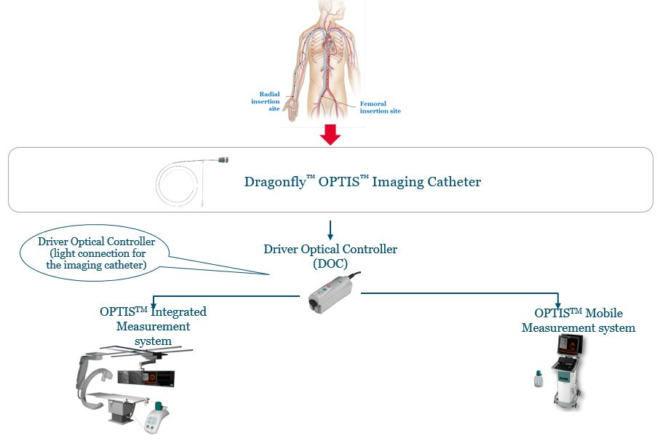

Slide 63
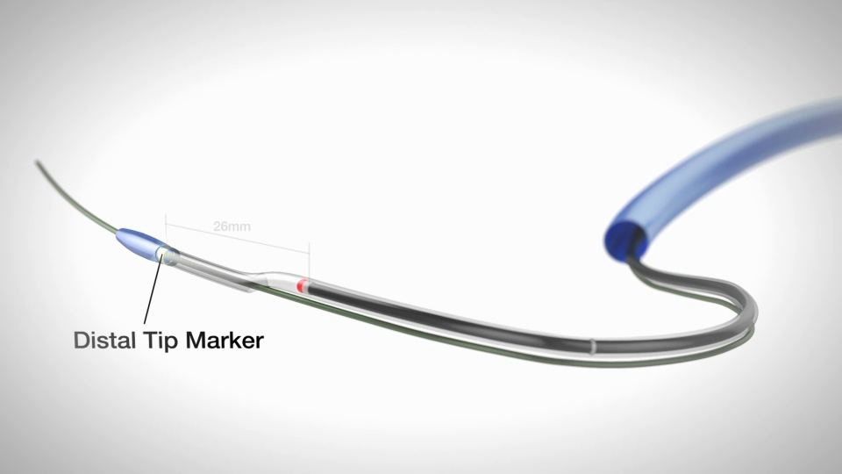
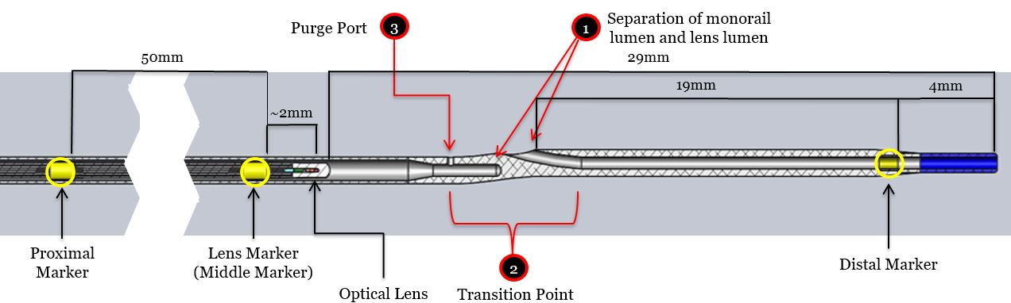
Distance from the Distal marker to Lens Marker = 26mm
Distance from Lens Marker to the proximal Marker= 50mm
Frame the specific region of interest in the High-resolution Mode
Distance from lens to Lens marker is = 2 mm

Slide 64
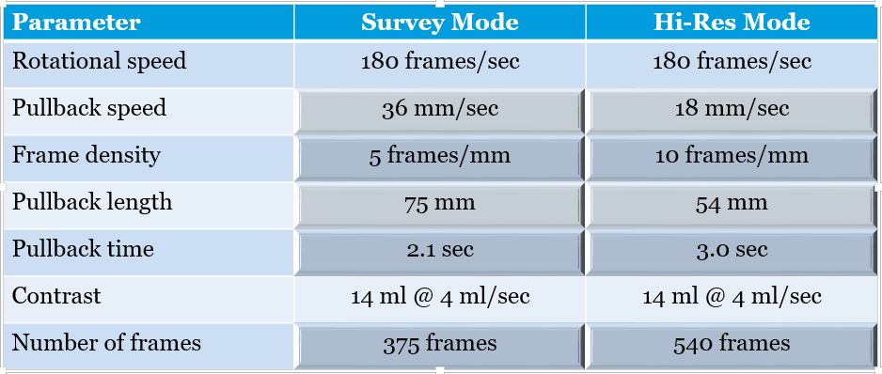

Slide 65
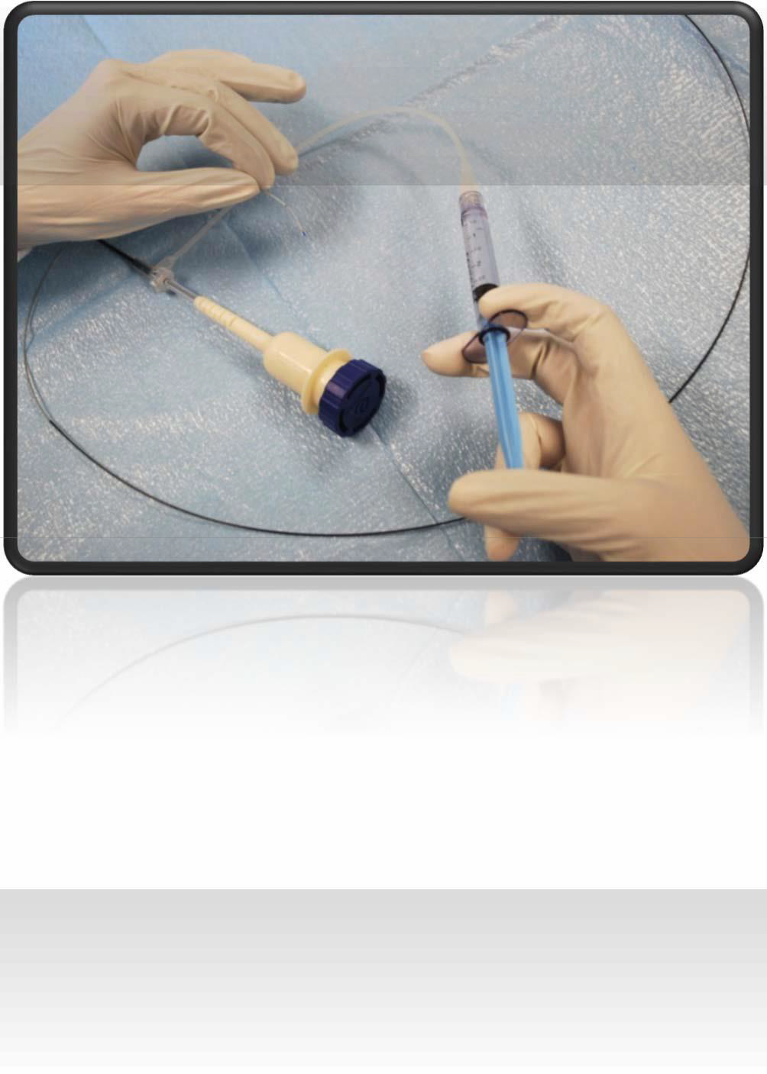
IMAGE ACQUISITION:CATHETER PREPARATION
Remove catheter from hoop
Wipe shaft to activate hydrophilic coating
Gently purge catheter with 3ml syringe filled with 100% contrast PRIOR to connection
Inject until 3 drops exit tip
Leave syringe attached for repeat purging in vivo
Connect the catheter to DOC

Slide 66
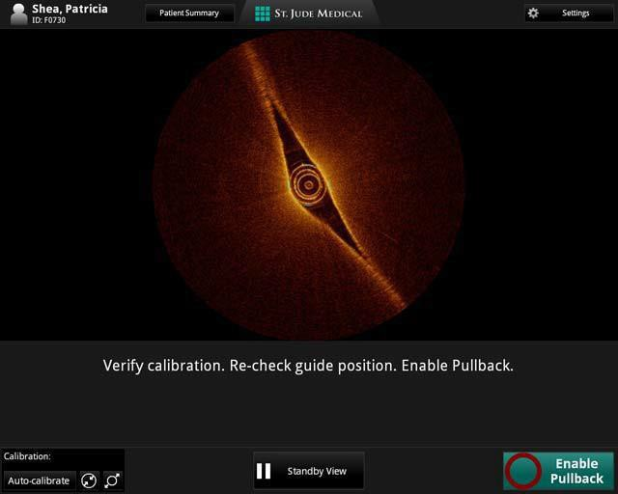
TEST IMAGE
To Test the Image hold the catheter
CONFIDENTIAL – FOR INTERNAL USE ONLY

Slide 67
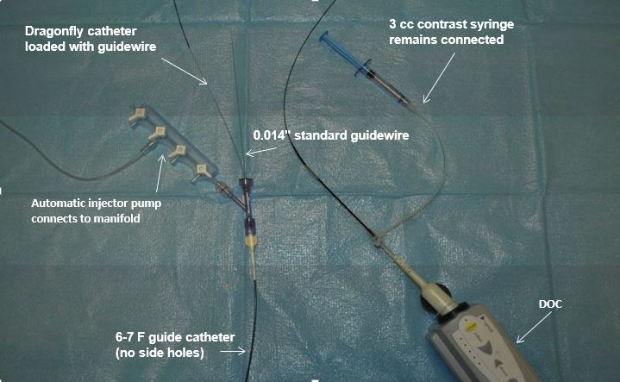
IC nitro-glycerine given(at least 200 µg)

Slide 68
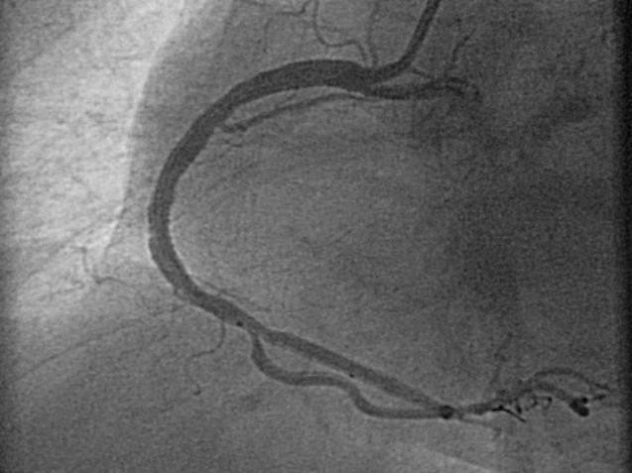
POSITIONING DRAGONFLY DUO/ OPTIS
Pullback length: 54mm Or 75mm
Proximal and Lens markers are on the torque wire and then the markers move during the pullback
POI 54MM
POI 75MM
Markers 50 mm apart
Proximal Marker
Lens
Marker ^{Lens}
2 mm
Distal Marker
Markers 26 mm apart
Insertion and positioning of the Dragonfly catheter should be done in
the “Stand by” Mode

Slide 69
Approved Injector Pump Settings
100% contrast only
4 ml/sec or less flush rate
14 ml or less total flush volume
Pressure limit: 300 psi or the nearest available setting

Slide 70
Risks/complications
  Ventricular fibrillation (1.1%) (due to balloon occlusion or deep guide catheter insertion or both)
  Air embolism (0.6%)
  Vessel dissection (0.2%).
  Chest pain - most commonly seen complication
Notes:
the very high speed of the pullback, FD-OCT has the ability to scan longer segments of artery in few seconds, without need to occlude the vessel, resulting in minimal ischemic electrocardiographic changes and no major arrhythmias during imaging acquisition

Slide 71
Artifacts
Seam line artifact - rapid artery or imaging wire movement during single-frame imaging formation → misalignment of the luminal border
Nonuniform rotational distortion - shape distortion and mirror artifacts
Image attenuation - suboptimal purge of the imaging catheter
Image attenuation - subobtimal flushing of the coronary artery
Notes:
B. NURD fewer than OCT

Slide 72
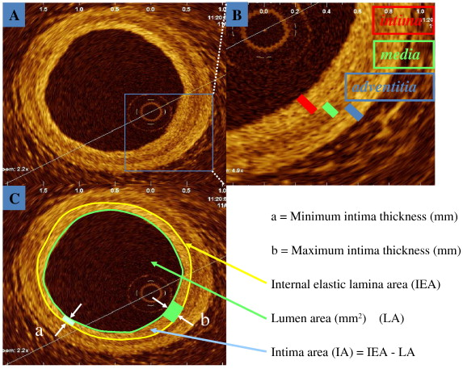

Slide 73
  Fibrous plaques: homogeneous signal-rich regions
  Fibrocalcific plaques: signal-poor regions with sharp borders
  Lipid-rich plaques: signal-poor regions with diffuse borders

Slide 74
Notes:
Normal
Intimal thickening
Fibrous plaque with concentric intimal thickening
Fibroatheroma lesion with lipid pool and an overlying thick fibrous cap (cap thickness = 500 μm)
Thin-cap fibroatheroma. The lipid-rich plaque has a cap thickness of less than 65 μm (from 4 to 8 o’clock, the cap thickness = 60 μm)
Fibrocalcific plaque with 360 degrees of calcified arc, signal-poor, heterogeneous region, sharply delineated borders

Slide 75
Coronary thrombus
White thrombus - homogeneous, signal-rich, irregular mass with low-backscattering attenuation
Red thrombus – irregularly shaped, mural or luminal mass protruding into the lumen, characterized by high-backscattering attenuation and signal-free shadowing
Kume and colleagues, cutoff value of 250 μm in half-width of signal attenuation to differentiate white from red thrombi - sensitivity (90%) and specificity (88%)
Notes:
3. 1/2 attenuation width of the signal intensity curve, which was defined as the distance from peak intensity to its 1/2 intensity

Slide 76
Notes:
White thrombus (8 to 9 o’clock) is visualized as intraluminal, protruding tissue with low attenuation and low backscattering of the optical signal
Red thrombus (7 to 10 o’clock) is identified as a high-backscattering mass that protrudes into the lumen with signal-free shadowing due to high attenuation
Recanalized thrombus is characterized by signal-rich, high-backscattering septa dividing the vessel lumen into multiple small cavities that communicate with each other (“Swiss cheese” morphology at apthology assessment)

Slide 78
Notes:
Coronary angiogram displays minimal perivascular contrast at the body of the left main coronary (LM, arrow)
pullback technique → large lumen at the left main site with thin-cap fiberatheroma (minimum cap thickness = 40 μm)
multiple plaque ruptures (C, D, and E) involving the proximal body
F. Three-dimensional navigation views display the locations of plaque disruptions

Slide 79
STENT ASSESSMENT
Useful at various stages of stent placement
  Mapping the vessel pathology before implantation
  Optimizing the stent deployment
  Quantifying the degree of stent coverage
  Evaluating the mechanisms of delayed healing and thrombus formation

Slide 80
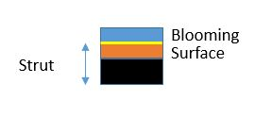
Strong reflectors of light and appear as bright points, shadow generated behind – blooming
  Luminal surface of the strut -expected to be found in the middle of the blooming -half of blooming value used as standard for calculation
High signal reflection generated by the metallic stent strut can be identified through blood
Notes:
1. Blooming & shadow may be mistaken for malapposition
2. can be used clinically to allow proper positioning of the imaging catheter distal to the area of interest in a way to cover the full stent length while imaging

Slide 81
BVS – light can penetrate the struts - ‘‘boxed appearance’’ of individual stent struts – persists until total degradation
  only part of light is reflected at the endoluminal and abluminal sides of the struts – vessel wall can be imaged through the struts without any major signs of attenuation
NEVO stent, sirolimus-eluting stent with a biodegradable polymer and reservoir technology - ‘‘tram trail’’ appearance

Slide 82
Questions
FFR value taken to be significant is less than
  A .0.5
  B. 0.7
  C. 0.8
  D. 0.9

Slide 83
Where the pressure sensor in FFR catheter is usually located
  A. At the tip
  B. 1cm from the tip
  C. 2cm from the tip
  D. 3cm from the tip

Slide 84
What is the dose of IV adenosine for FFR measurement?
  A. 50 mcg/min
  B. 140 mcg/kg/min
  C. 140 mcg/min
  D. 50 mcg/kg/min

Slide 85
All are true for solid state IVUS catheter except
  A. Tracks better
  B. distance of the transducer from the catheter tip is shorter - beneficial in IVUS-guided intervention of CTO
  C. No moving parts – free from NURD
  D. Higher frequency and resolution

Slide 86
Maximum contrast volume and rate of injection in OCT
  14ml @ 4ml/sec
  12ml @ 4ml/sec
  14ml @ 6ml/sec
  12 ml @ 6ml/sec

Slide 87
THANK YOU

